Slide 1

Aviation Safety Trends
By Pascal Berlage and Elias Kouevidjin

Slide 2
Context
1) We want to find out which type of plane accident (human error, mechanical failure, or both) is more common.
2) To determine how aircraft category (commercial, private, cargo) influences accident fatality rates.
This was analyzed using a dataset from Kaggle, containing thousands of aviation accident observations. The size of the dataset creates a normal distribution, which helped draw a reliable conclusion for aviation safety.

Slide 3
Hypothesis Methods
By Cause (Human, Mechanical, Combined):
H₀: µ_Human = µ_Mechanical = µ_Combined
H₁: At least one pair of means differs.
By Aircraft Type (Commercial, Private, Cargo):
H₀: µ_Commercial = µ_Private = µ_Cargo
H₁: At least one pair of means differs.
One Way ANOVA – Comparing Mean Fatalities with:
Cause categories (Human, Mechanical, Combined).
Aircraft categories (Commercial, Private, Cargo).
Tukey’s HSD: Identify specific group differences post-ANOVA.

Slide 4
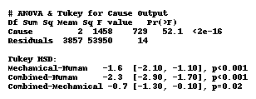

Fatality Differences by Human/Mechanical Cause: ANOVA (R Code)

Slide 5
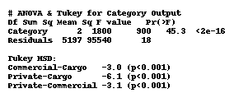

Fatality Differences by Aircraft Type: ANOVA (R Code)

Slide 6
Results
ANOVA F(2,3857)=52.1, p<0.001 shows mean fatalities differ by cause.
ANOVA F(2,5197)=45.3, p<0.001 confirms differences among types.
Both ANOVAs rejected the null hypotheses, confirming significant differences in mean fatalities:
By Cause: Human (7.1) > Mechanical (5.5) > Combined (4.8).
By Aircraft Type: Cargo (9.2) > Commercial (6.2) > Private (3.1).
Post-hoc Tukey HSD tests confirmed all pairwise differences were statistically significant.

Slide 7

Conclusion
Human Error = Deadliest Cause
• 29% higher fatalities than mechanical failures (7.1 vs. 5.5 deaths/accident)
• Implication: More pilot training could save more lives than mechanical upgrade
Cargo Aircraft = Highest-Risk
• 48% deadlier than commercial flights (9.2 vs. 6.2 deaths/accident)
• Implication: Focus on cargo maintenance & hazardous material protocols

